Slide 1
MNE-Python workshop
About Us – MNE project info – Plan Eric Larson and Mainak Jas

Slide 2
About us
Eric Larson, Ph.D.
Ph.D. in Biomedical Engineering (Boston U.)
Research scientist at ILABS (Univ. of Washington)
As a postdoc, converted all of the lab’s (Adrian KC Lee) MATLAB code in 2011
Mainak Jas, Ph.D.
Ph.D. in Signal and image processing (Telecom ParisTech)
Postdoc with Matti Hämäläinen at MGH
Each have 60,000+ lines of code changed in MNE-Python

Slide 3
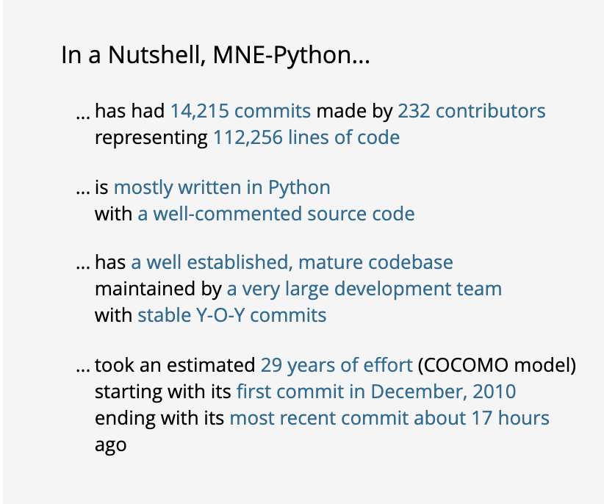
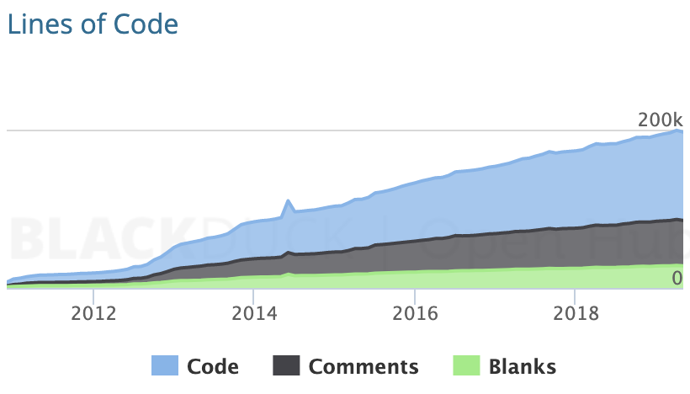
About the project
MNE-C: Project started by Matti Hämäläinen (MGH) ~20 years ago
MNE-Python: Started by Alexandre Gramfort (INRIA) ~10 years ago
https://www.openhub.net/p/mne

Slide 4
Some things you can do with MNE
Read data
Preprocessing (SSP, ICA, Maxwell filter, etc.)
Evoked analyses (ERF/P)
Time-frequency analyses
Source localization
Connectivity
Statistics
Decoding/Encoding (machine learning)
… improve it by contributing!

Slide 5
What’s the plan?
Day 1:
(This intro)
Python
NumPy
MNE raw data to evoked
Day 2:
Preprocessing
Forward / cov / inverses
Day 3:
Decoding / machine learning
Connectivity and statistics
Contributing to MNE
Work with your own data each day, try out what we’ve taught or work ahead!
Don’t hesitate to ask questions!

